Slide 1

Basic Details of the Team and Problem Statement
Ministry: Ministry of Jal Shakti
PS Code: SIH1293
Problem Statement Title: Automatic regulations of valves for release of water.
Team Name: Loop Escaper’s
Team Leader Name: Abhijeet Swami
Institute Code (AISHE): C-28184
Institute Name: Aravali College of Engineering and Management.
Theme Name: Agriculture, Food Tech & Rural Development

Slide 2
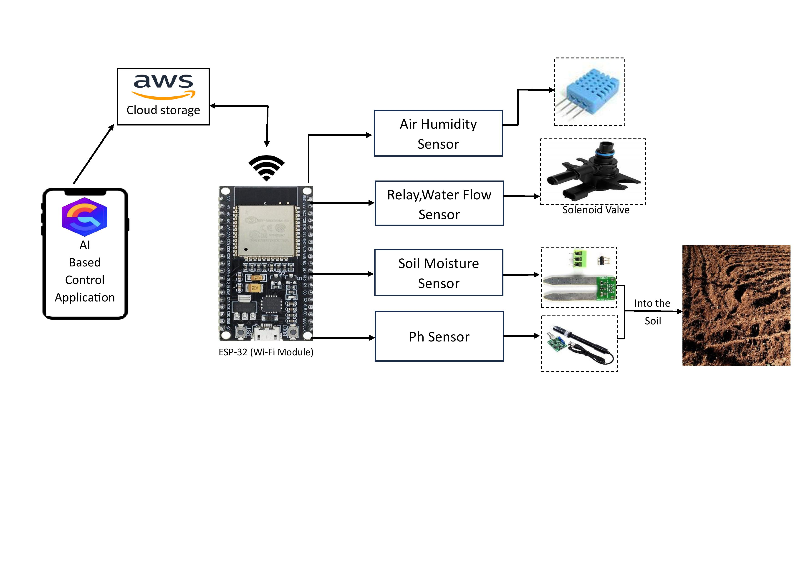

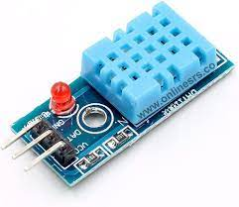
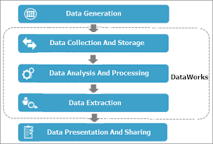

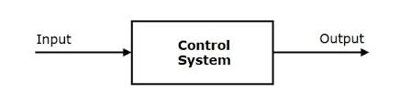

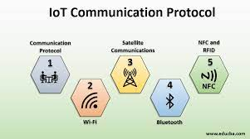
Idea/Approach Details
Idea :-
Our idea is to introduced an Smart AI based irrigation system in Cheap Cost that decreasing Human Labor &Effort .
An AI System That analyzes IOT based data to determine the Optimal Irrigation schedule.
It supply water with ensuring that plants receive the right amount of water at perfect time by the use of
Quantum Database .
Approach Details :- If the Updated smart system worked according to the plan and Design then it gives Optimized Device for Smart Farming
By the following process our Device worked in Real World :-
Sensors Data Storage
Weather Data Control system
Security Measures Communication Protocols
Valve Status(On/Off)
User Interface
Internet of Things
Data Collection
Neural Network(DL)
Working Process

Slide 3
Idea/Approach Details
Business Model
Sales
There are some Statistics or Assumption by which our AI System can give the raise of smart AI in Agriculture Field .
** Versatile Irrigation Compatibility ** :-
- The product, priced at 1500 Rs per set, adapts to Surface, Sprinkler, Drip, and Subsurface systems.
- A 20% cost reduction, lowering the price to 1000 Rs, benefits various farming methods.
** Economic Impact ** :-
- With just 10% adoption by farmers, over a few month, sales can reach over One million Rs.
- It have a potential to generate substantial economic value.
** Diverse Farming and Irrigation Integration **:
- The device smoothly integrates with Subsistence, Commercial, Organic, and Dryland Farming practices.

Slide 4
Team Member Details
Team Leader: Abhijeet Swami
Branch: B.Tech Stream: CSE(AIML) Year: III
Team Member: Priyanshu Kr. Choubey
Branch: B.Tech Stream: CSE (AIML) Year: III
Team Member: Ayush Kumar
Branch: B.Tech Stream: CSE (AIML) Year: III
Team Member: Priya Jha
Branch: B.Tech Stream: CSE (AIML) Year: III
Team Member: Rishika Mishra
Branch: B.Tech Stream: CSE Year: III
Team Member: Shivam Jha
Branch: B.Tech Stream: CSE Year: IV
Team Mentor Name: Mr. Mahesh Swami
Category :Academic Expertise :AI/ML Domain Experience : 4-5 years
Team Mentor Name: Ms. Rashika Singh
Category :Academic Expertise :AI/ML Domain Experience : 4-5 years

